Slide 1
Application of Systematic Design Methods to Cultural Heritage Preservation
Lorenzo Fiorineschi¹, Roberta Barsanti², Gaetano Cascini³, Federico Rotini¹
¹Department of Industrial Engineering, University of Florence, Italy
²Museo Leonardiano of Vinci, Italy
³Dipartimento di Meccanica, Politecnico di Milano, Italy
lorenzo.fiorineschi@unifi.it
Firenze, 04-16 October, 2020

Slide 2
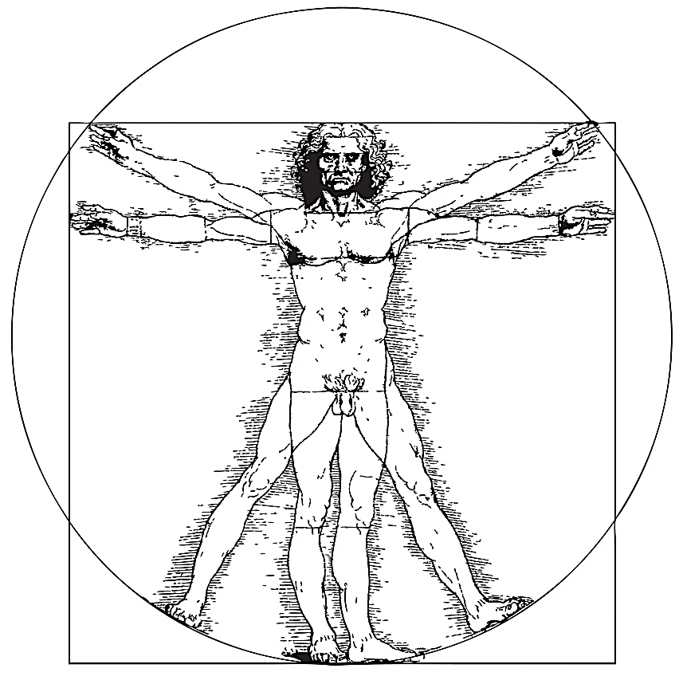
Summary
Systematic design and problem solving approaches
Application examples
Systematic redesign of the Leonardo’s hydraulic saw.
Conclusions

Slide 3
Systematic design and problem solving approaches
The systematic design approach
One of the most acknowledged engineering design systematic approaches is the German one, which divides the design process into four (iterative) main phases:
Task clarification (formulation of the design task a setting up of the design requirement list)
Conceptual design (conceiving and outlining design ideas)
Embodiment design (early materialization of the ideas into realistic design outcomes)
Detail design (the final design is produced with all the required details)

Slide 4
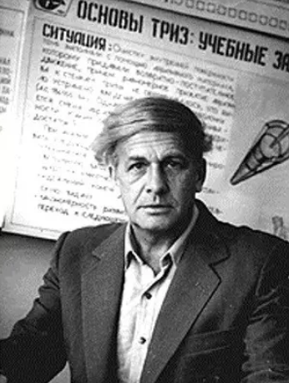
Systematic design and problem solving approaches
The TRIZ theory for systematic problem solving
ТРИЗ
TRIZ is the Russian acronym for “Teoriya Resheniya Izobretatelskikh Zadach”, i.e. the “theory of the resolution of inventive problems” that was formerly developed by Genrich Altshuller.
Technical systems evolve according objective laws
Any specific technical problem can be represented through generalized problem models
Standardized solving principles can be used to solve apparently different technical problems

Slide 5
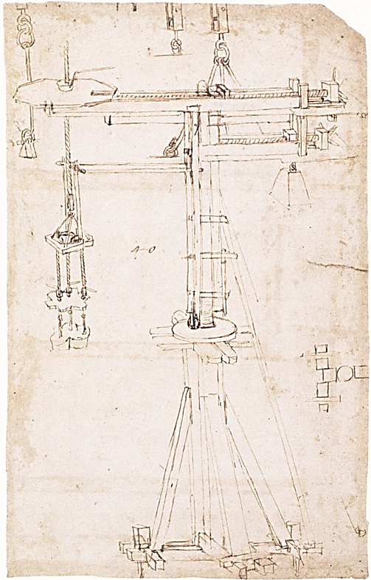
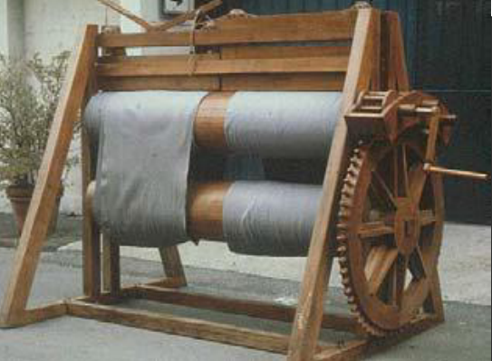
Examples of possible applications
The TRIZ-based classification of the cranes designed by Filippo Brunelleschi
TRIZ inventive principles and evolutionary laws have been successfully exploited to support historians classification of the cranes designed by Brunelleschi to build the Dome of the S. Maria del Fiore Cathedral.
G. Cascini, R. Nanni, and D. Russo, “TRIZ Patterns of Evolution as a means for supporting History of Technology : analyzing the Brunelleschi ’ s Dome cranes,” TRIZ Journal, no. July, 2003.
D. Russo, “I modelli di evoluzione tecnologica TRIZ come strumento di supporto per la Storia della Scienza e della Tecnica – Il Cantiere di S. Maria del Fiore,” Università degli Studi di Firenze, 2003.
TRIZ has been also used in a similar application focused on Leonardo da Vinci’s textile machines.
G. Cascini, D. Russo, and R. Nanni, A Contribution to History of Technology: Analyzing Leonardo’s Textile Machines and His Inventive Process by TRIZ Methods. Florence, 2004

Slide 6
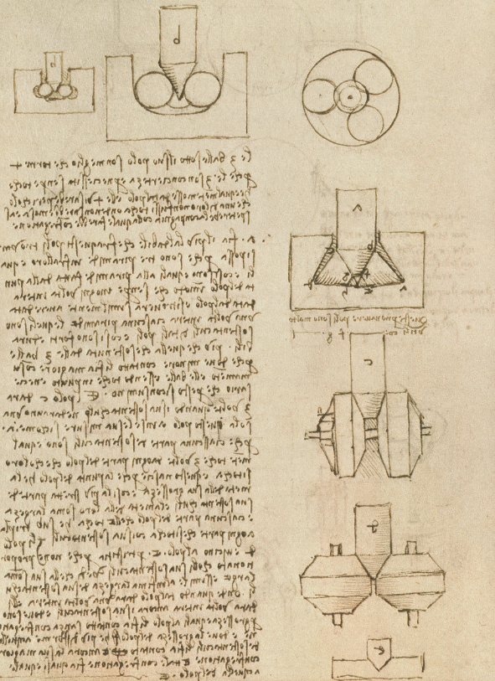
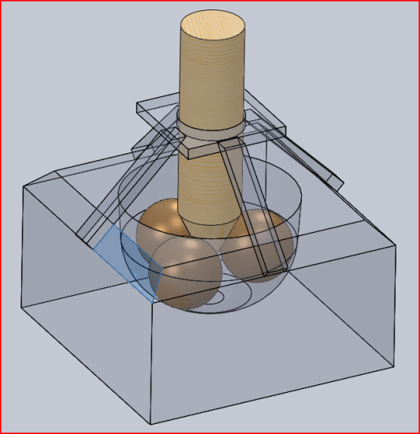
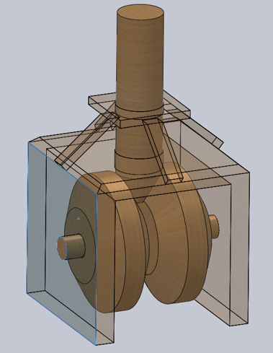
Examples of possible applications
Embodiment design of the Leonardo’s axial bearings
By assuming the Leonardo’s documents as the outcome of the conceptual design phase, it was possible to proceed with the embodiment design phase, identifying the criticalities of the Leonardo’s sketches.

Slide 7
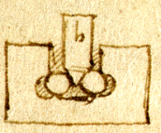
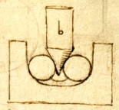
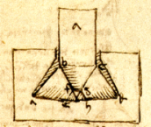
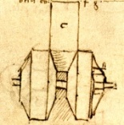
Examples of possible applications
Embodiment design of the Leonardo’s axial bearings

Slide 8
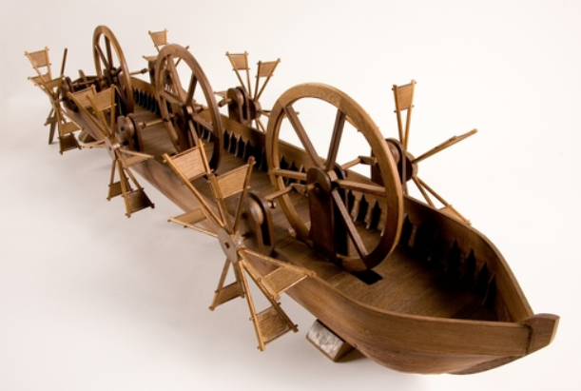
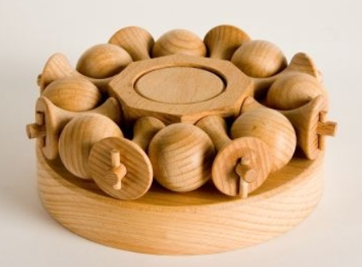
Examples of possible applications
Design of physical models for the “Museo Leonardiano” of Vinci
From Leonardo’s Atlantic code f. 1063r
From Leonardo’s Madrid code f. 020v

Slide 9
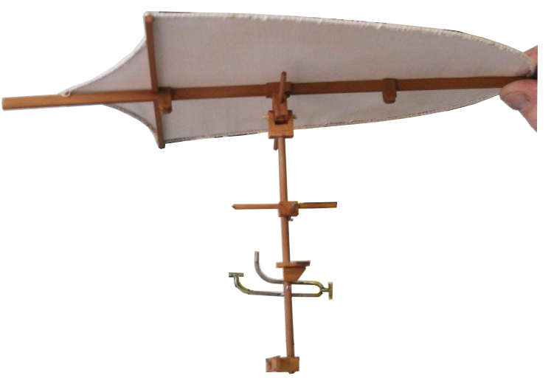
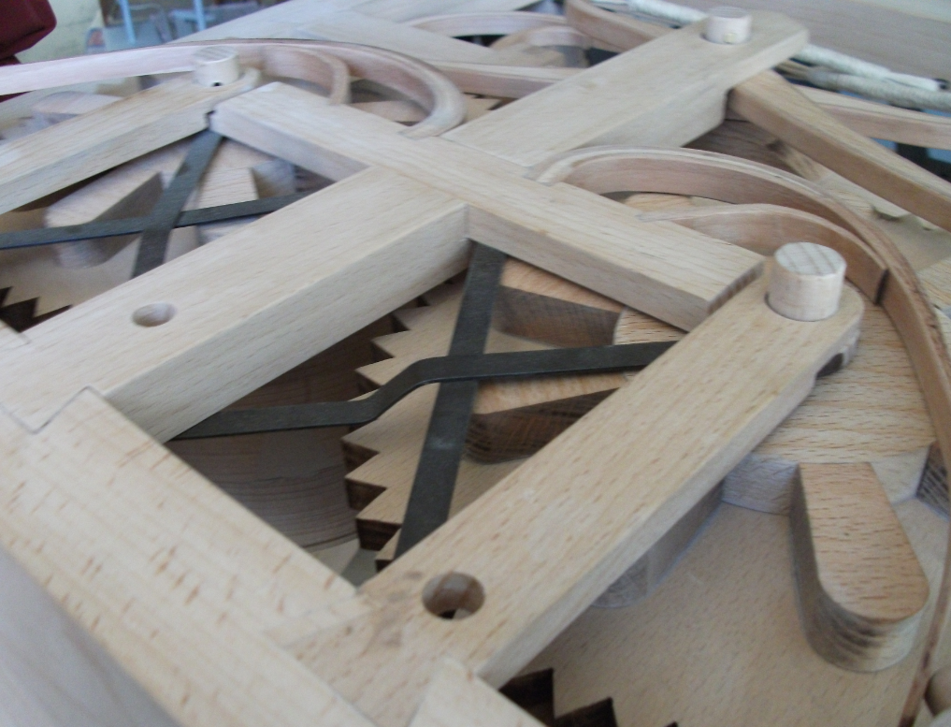
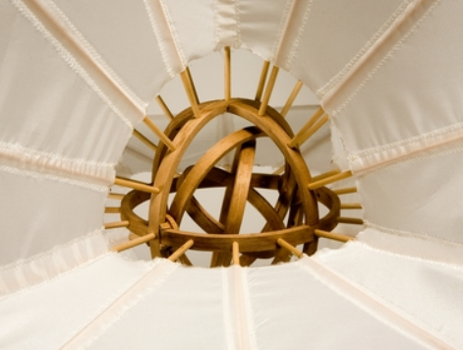
Examples of possible applications
Design of physical models for the “Museo Leonardiano” of Vinci

Slide 10
Systematic redesign of the Leornardo’s hydraulic saw.
(Cod. Atl. F 1078r).
TASK CLARIFICATION
A new and fully functional model of the hydraulic saw of Leonardo (Cod. Atl. F 1078r)
Realistic materials and appearance.
Design requirements about geometry (especially the size), kinematics, materials,
Forces to allow human interaction with the model
Production process and available budget

Slide 11
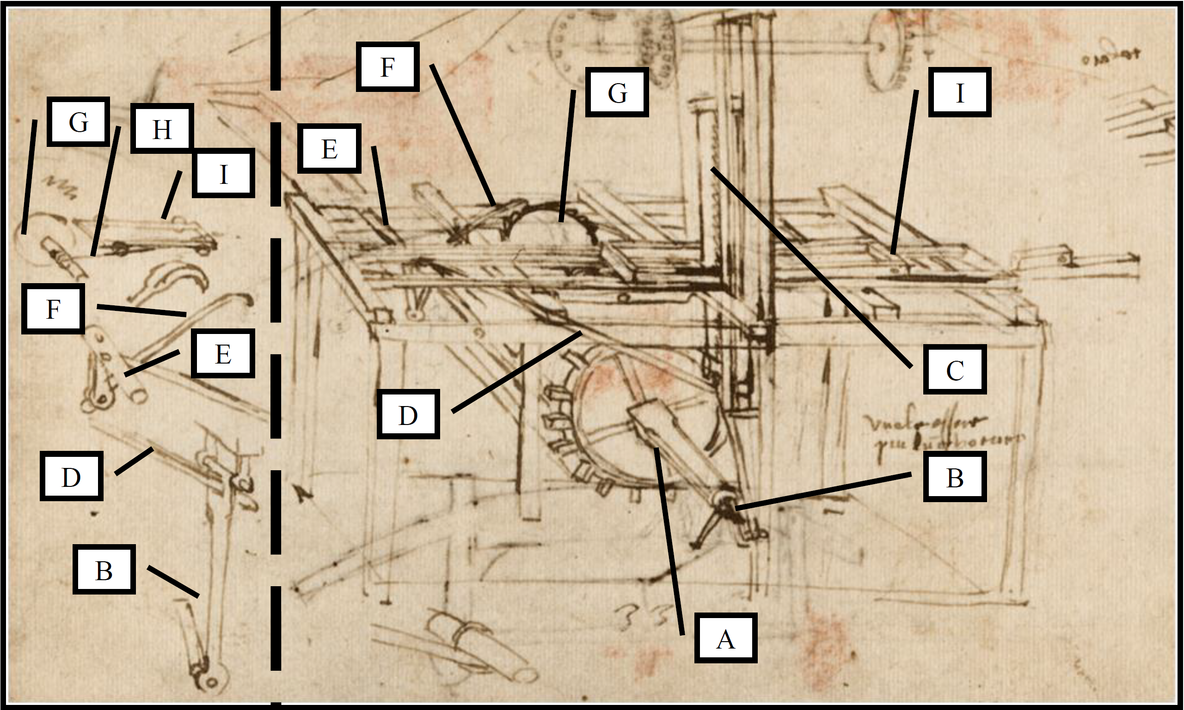
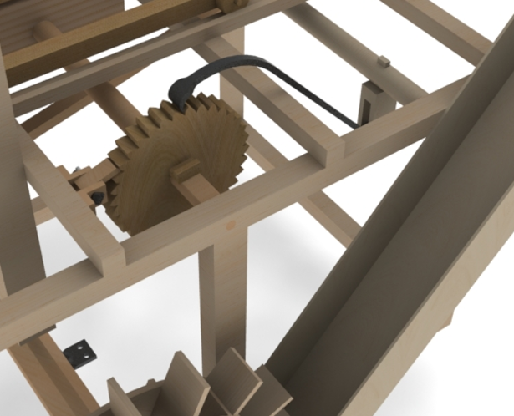
Systematic redesign of the Leornardo’s hydraulic saw.
(Cod. Atl. F 1078r).
ITERATIONS BETWEEN CONCEPT AND EMBODIMENT
Iterative embodiment design in order to identify all details and to understand the related functional meaning

Slide 12
Systematic redesign of the Leornardo’s hydraulic saw.
(Cod. Atl. F 1078r).

Slide 13
Systematic redesign of the Leornardo’s hydraulic saw.
(Cod. Atl. F 1078r).

Slide 14
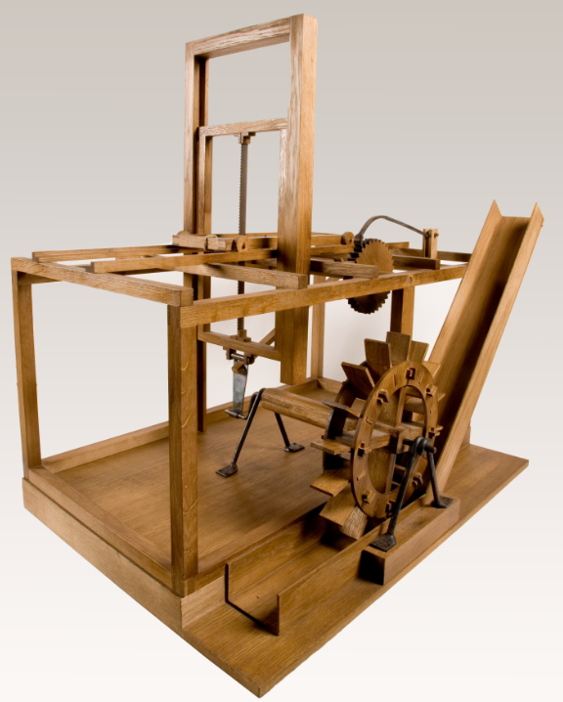
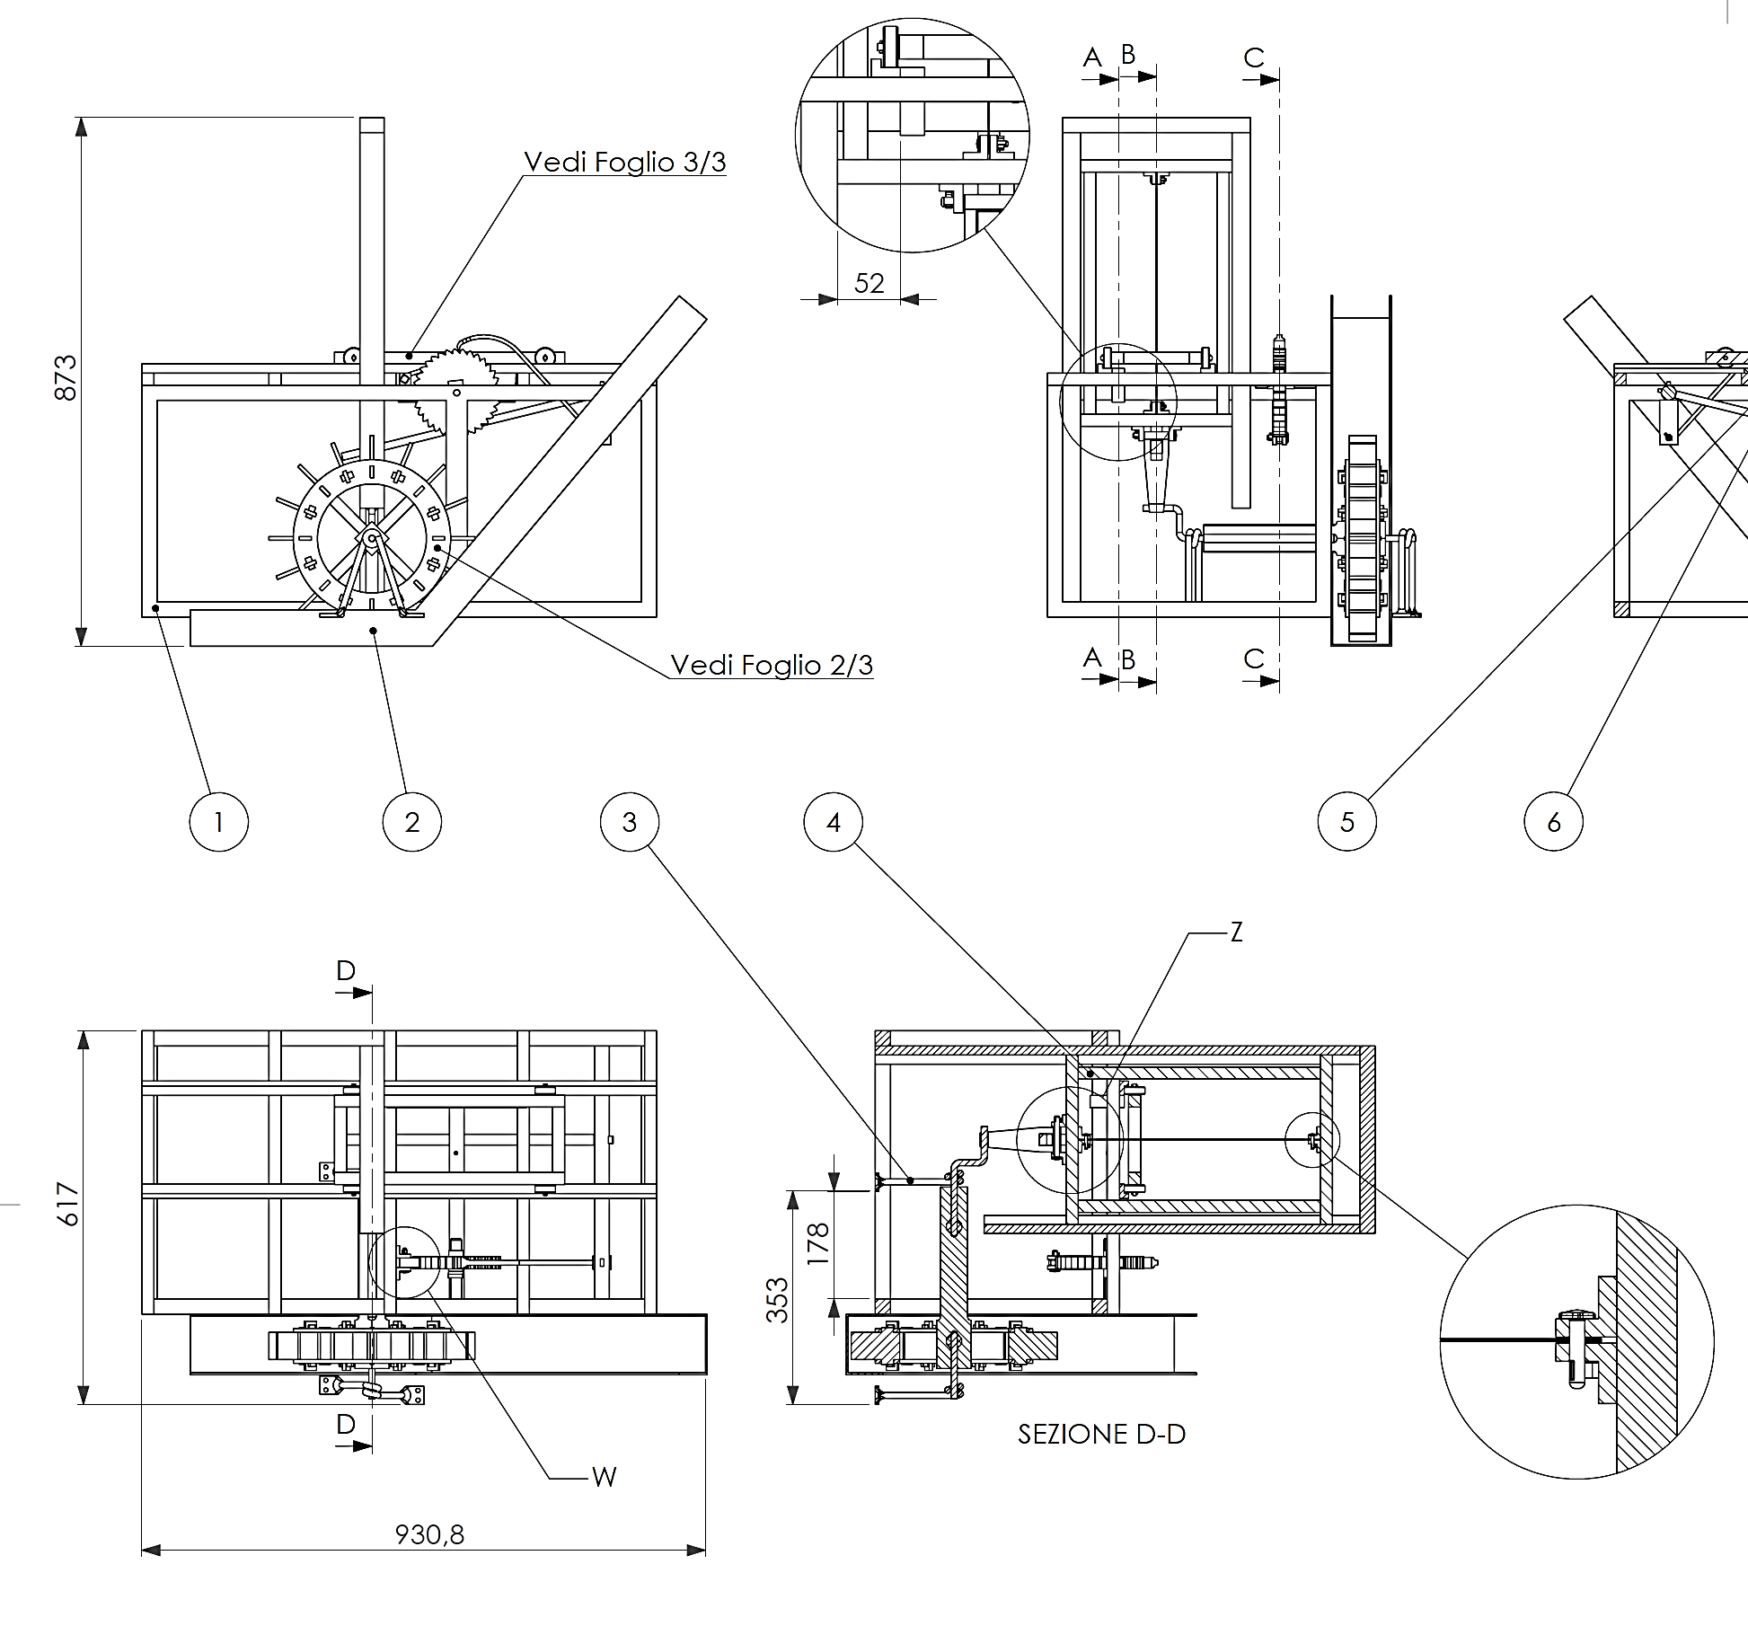
Systematic redesign of the Leornardo’s hydraulic saw.
(Cod. Atl. F 1078r).
DETAIL DESIGN TO ALLOW THE MANUFACTURING OF THE WORKING MODEL

Slide 15
Conclusions
The aim of this presentation is to provide a short and non-representative overview of the possible support that the systematic design methodologies can provide in cultural heritage tasks.
The field of application is not limited to design tasks, but the available tools and procedures can be conveniently used for a plethora of other applications, like the classification and/or the analysis of the technological evolution path.
Design method can also support creativity in the design of any physical device involved in cultural heritage operations, allowing the designers to rapidly identify cost-effective solutions with the highest possible efficiency.

Slide 16
Thank you for attention
gaetano.cascini@polimi.it
www.dief.unifi.it
lorenzo.fiorineschi@unifi.it federico.rotini@unifi.it
r.barsanti@comune.vinci.fi.it

