Slide 1


In-situ checking various mechanical parameters of original nail connections between crossbeams and wooden support, in the framework of an innovative method for rationally dimensioning the crossbeams of panel paintings, applied on an original artwork
MAZZANTI Paola¹, RIPARBELLI Lorenzo¹, GUALDANI Giovanni², CASTELLI Ciro², RICCIARDI Luciano², SANTACESARIA Andrea² , TOGNI Marco¹, UZIELLI Luca¹
¹ DAGRI (former-GESAAF), University of Florence, Florence, Italy
² Opificio delle Pietre Dure, Florence, Italy
Florence
14-16 October 2020

Slide 2
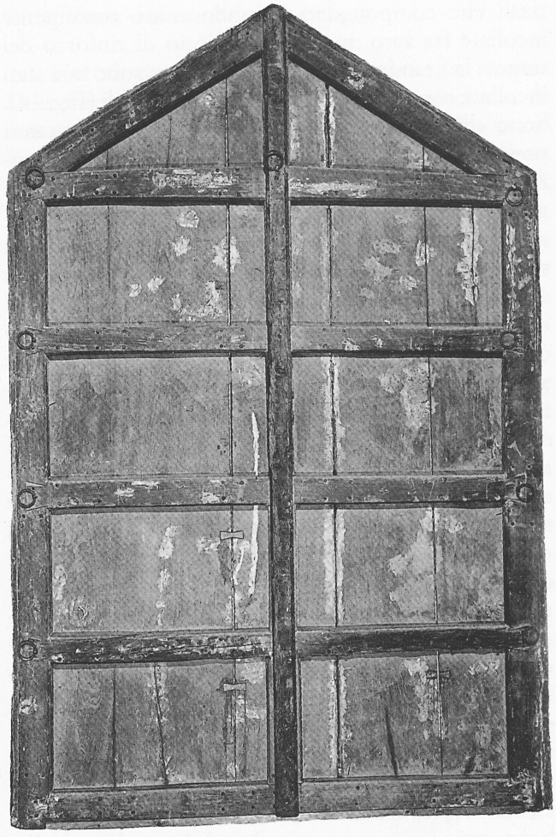
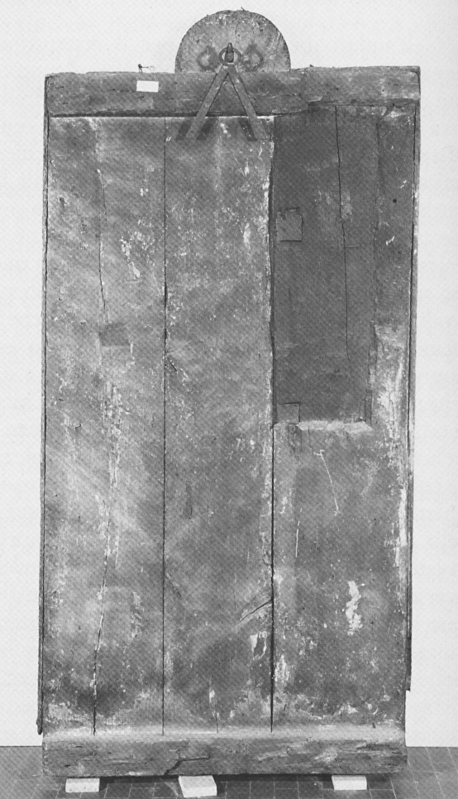
Introduction: the wooden support and its restraining system
Image in oblique lighting
Conservazione dei dipinti su tavola, Nardini, Ed., 1998

Slide 3
Introduction: the wooden support and its restraining system
Wooden bridged crossbeams
Dovetail crossbeams
Nailed crossbeams

Slide 4
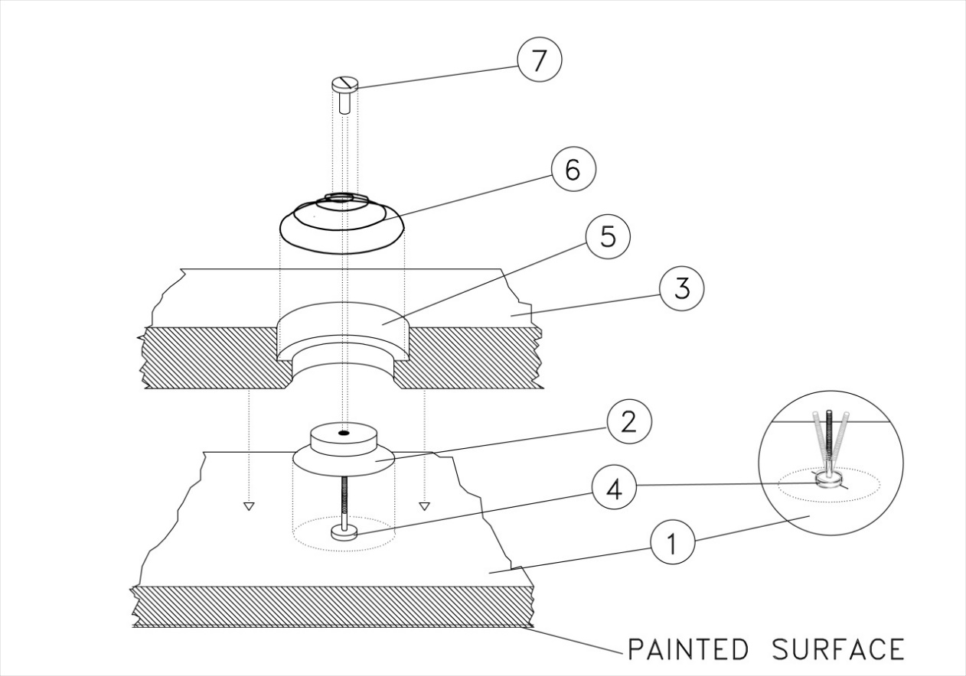
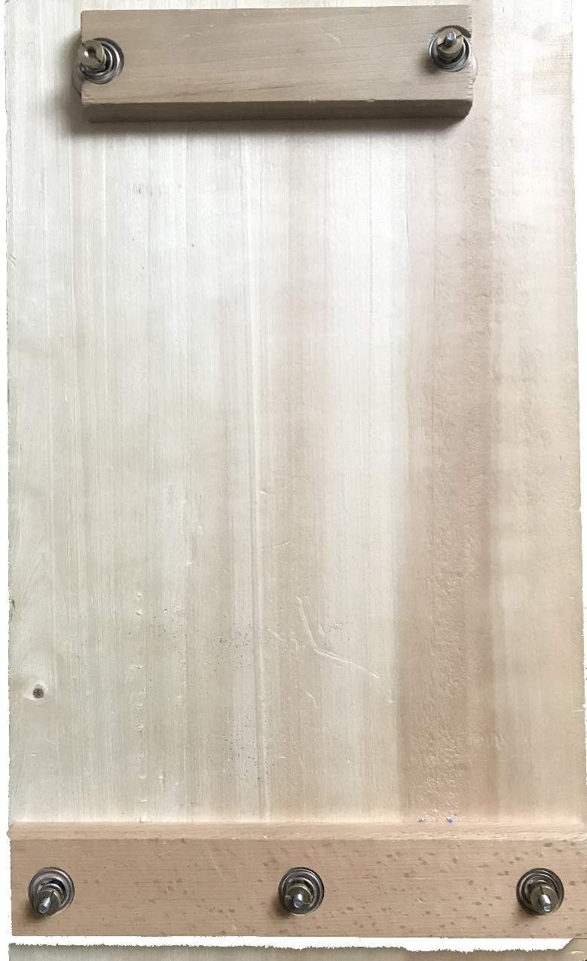
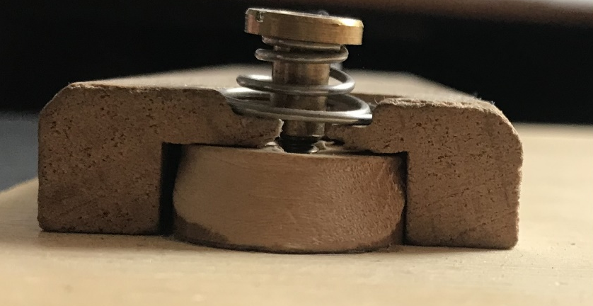
Introduction: the elastic auxiliary system and its components
RETAINING NUT
TAPERED HELICAL STEEL SPRING
MOLDED HOLE
CROSSBAR
BUTTON
SCREW
BACK FACE OF THE PANEL

Slide 5
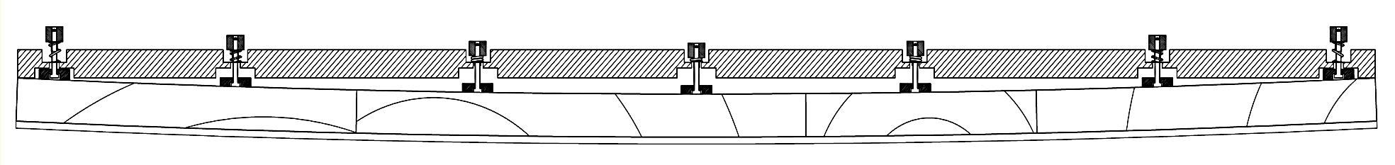
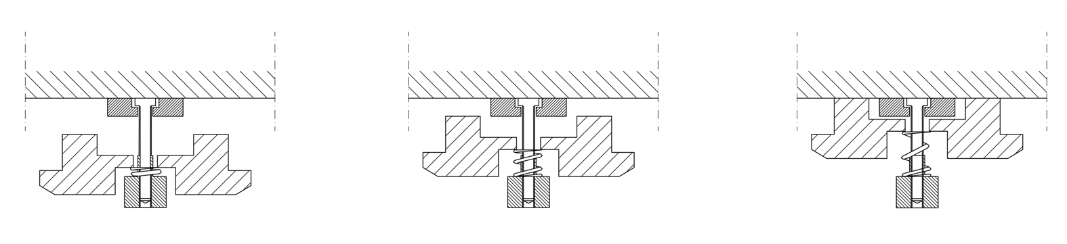
Introduction: how the elastic support system works
L. Cocchi , Advanced methodologies to study the mechanical behaviour of panel paintings, Ph. D. Thesis, Florence, 2013

Slide 6
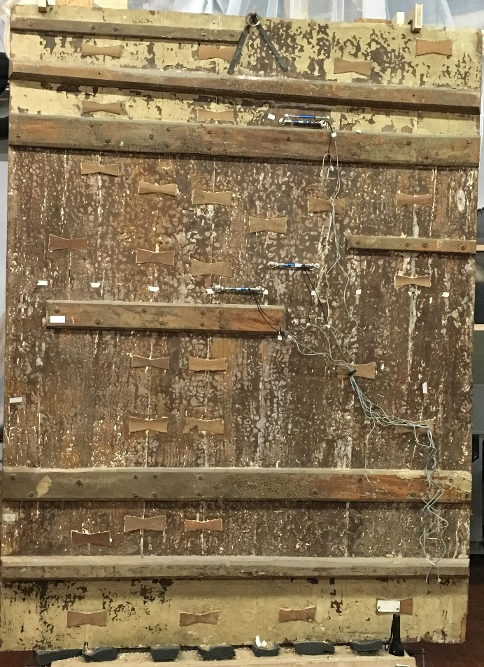
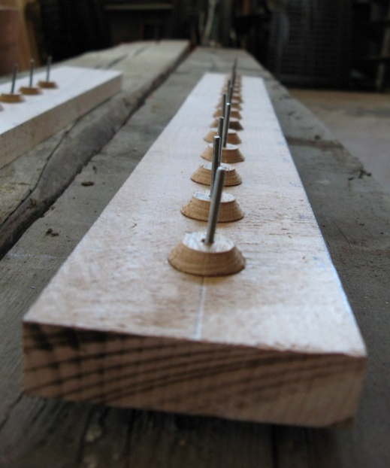
Introduction: the collaboration between Opificio delle Pietre Dure and DAGRI
Mechanical tests on the buttons, a component of the elastic auxiliary support
Deposizione di Sansepolcro Rosso Fiorentino
1528
Deposizione dalla Croce
Anonimo Abruzzese
XVI century

Slide 7
Introduction: the Cesare da Sesto’s project
C. Castelli et al. (2018) Il restauro del support ligneo della Natività attribuita a Cesare da Sesto. Messa a punto di un metodo per il dimensionamento e l’adeguamento elastic della traversatura originale, OPD Restauro 30: 186-204

Slide 8
Introduction: an innovative protocol for dimensioning the crossbeams
Restoration Plan developed by Restorers and Conservators
Mechanical tests to evaluate the stiffness of the wooden panel and the crossbeams
Hygroscopic test to determine the hygroscopical behaviour of the wooden panel alone
Dimensioning the new crossbeams by means of an ad-hoc numerical model
Numerical and/or experimental verification of the dimensioning
C. Castelli et al. (2018) Il restauro del support ligneo della Natività attribuita a Cesare da Sesto. Messa a punto di un metodo per il dimensionamento e l’adeguamento elastic della traversatura originale, OPD Restauro 30: 186-204

Slide 9
Research aims
To assess:
the holding capacity of the nails aiming to ensure that the in-situ original nails can withstand the design load anticipated by the numerical modelling;
the residual restraining load, if any, still exerted through the nail between the wooden support and crossbeam;
the forces (if any, possibly caused by “friction”, “adhesion” or “encrustation”), that oppose the slippage of the nail shank with respect to the crossbar’s wood it crosses;
the elastic behaviour of the wooden support in transverse bending, at the time of testing.

Slide 10
Materials and Methods: mechanical tests
Both Force [N] and Deformation [mm] were measured were measured by a made-on-purpose measurement method.

Slide 11
Materials and Methods: the preparatory tests on a mock-up panel

Slide 12
Materials and Methods: the tested nail connections
5 connections were tested on the original artwork at the OPD by applying a maximum pull-out force of 500 N

Slide 13
Results: the mechanical tests on the original artwork, “free nail”

Slide 14
Results: the mechanical tests on the original artwork, preloaded nail

Slide 15
Results: the mechanical tests on the original artwork, preloaded nail
Preload value: 177 N

Slide 16
Results: the mechanical tests on the original artwork, “blocked nail”

Slide 17
Conclusions
Non-invasively mechanical tests have been carried out on an original artwork in the restoration laboratory by means of a made-on-purpose measurement method and apparatus;
some nails were still transmitting a force between the wooden support and the crossbeam, whereas others were totally unloaded; also, some nail shanks were completely blocked against the crossbeam, whereas others were completely free;
this method could be helpful to understand the internal forces still acting into the wood structure and possibly their influences on the degradation of the paint layers in relation to the behaviour of the wooden support and the crossbeams;
the tests performed constituted a sort of proof-loading, verifying that the original nails were able to withstand in operation a pull-out force of at least 500 newtons.

Slide 18

Thank you for your attention
paola.mazzanti@unifi.it

