Slide 1
Research on wall polychromes in the Saltworks Castle in Wieliczka
Anna Klisińska-Kopacz,¹ Pamela Grajny-Brzezińska,² Tomasz Wilkosz,¹
Michał Obarzanowski,¹ Klementyna Ochniak-Dudek,² Julio M. del Hoyo Melendez¹
¹The Laboratory of Analysis and Nondestructive Investigation of Heritage Objects, The National Museum in Krakow, Krakow, Poland
²Cracow Saltworks Museum in Wieliczka, Wieliczka, Poland

Slide 2
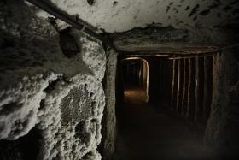
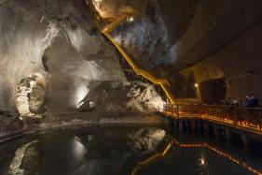
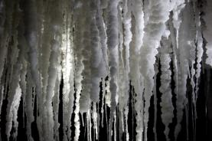
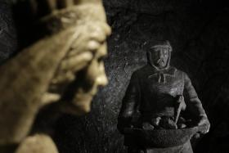
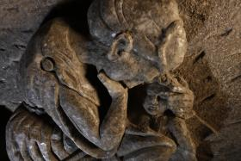
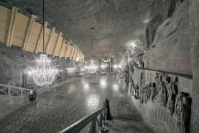
Wieliczka Salt Mine
The Wieliczka Salt Mine near Krakow, Poland, is one of the world's most famous salt mines, boasting a history of more than 700 years.
The subject of this research is a set of polychromies recently discovered in the interiors of the Wieliczka Saltworks Castle, which was the administrative centre for the Royal Salt Enterprise since the Middle Ages.

Slide 3
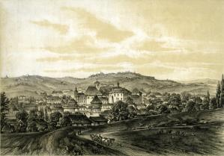
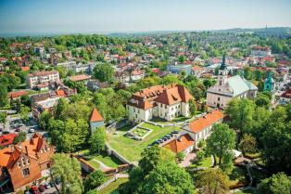
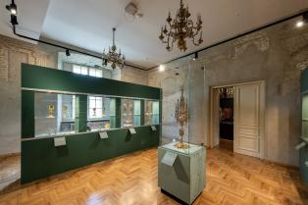
Saltworks Castle in Wieliczka
The Saltworks Castle has been developing since the 13th century in direct vicinity of a shaft hollowed out in search of salt. Over 650 years, the castle endured fires, wars, sieges, and other catastrophes, shaping its current form. The restoration work of the northern wing was completed in 2024. In recognition of its historical and cultural significance, the Wieliczka Saltworks Castle was inscribed in the UNESCO World Heritage List in 2013, as an extension of the existing entry related to the salt mines.

Slide 4
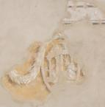
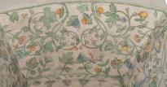
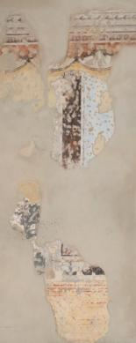
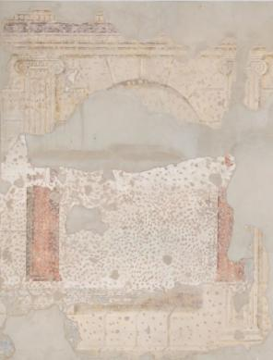
Discovered polychromies
In 2022, for the first time, wall polychromies from various chronological periods in six rooms on the first floor of the Northern Castle were fully uncovered from under thick secondary layers of plaster. The majority of preserved painting layers date back to the 19th century, with older layers to a lesser extent preserved.

Slide 5
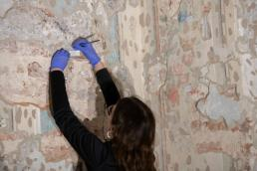
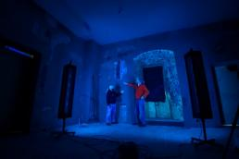
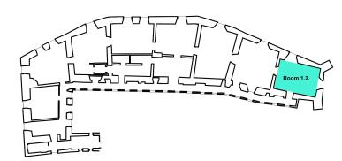
Experimental
Diagnostic tests for this study were conducted in the Northern Castle of Wieliczka Saltworks Castle, specifically in rooms on the first floor. The subject of this presentation are the wall paintings from the room with the designations 1.2.
VIS, UV photography
XRF analyses
FTIR spectroscopy
Microscopic observation of cross-sections
SEM-EDS analysis

Slide 6
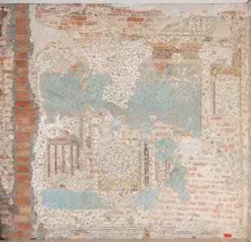
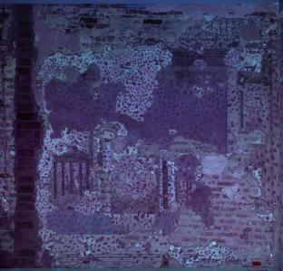
Room 1.2
In the northern wing of the Saltworks Castle, in the investigated room, three painted decorations were isolated. A general view of the northern wall with two decorations: the youngest one (1.2,I) and the earlier decoration underneath it (1.2,II).
VIS photography
UV
photography

Slide 7
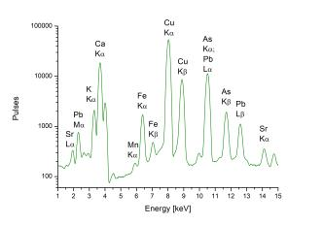
XRF analysis
1.2,I layer
Sample No. | Colour | Elements detected by XRF | Pigments
1.2,I,1 | Blue | K, Ca, Mn, Fe, Cu, As, Sr, Pb | Calcium carbonate, copper pigment (verditer), iron pigment (ochre, traces)
1.2,I,2 | White | K, Ca, Ti, Mn, Fe, Cu, As, Sr, Hg, Pb | Calcium carbonate, iron pigment (yellow ochre), lead white (traces), copper pigment (traces)
1.2,I,4 | Black | P, K, Ca, Mn, Fe, Cu, Zn, Sr, Ba, Pb | Bone black, calcium carbonate, iron pigment (ochre), copper pigment (traces), lead white (traces), barium white (traces)
1.2,I,6 | Red | Ca, Fe, Cu, Hg, Pb | Calcium carbonate, vermilion, lead pigment (lead white or minium)
1.2,I,8 | Green | K, Ca, Mn, Fe, Cu, As, Sr, Pb | Calcium carbonate, copper pigment (Scheele's green), iron pigment (ochre, traces), lead white (traces)
1.2,I,10 | Brown | K, Ca, Ti, Mn, Fe, Cu, Sr, Pb | Calcium carbonate, iron pigment (umber)
1.2,I,11 | Yellow | K, Ca, Ti, Mn, Fe, Cu, Zn, As, Sr, Pb | Iron pigment (yellow ochre), calcium carbonate, copper pigment (Scheele's green, traces), lead white (traces)
In the youngest painting decoration (1.2,I) calcium carbonate, yellow ochre, red ochre, vermilion, umber, verditer, Scheele's green and bone black were found.

Slide 8
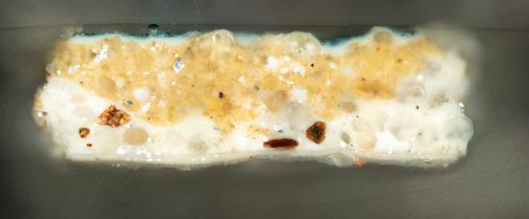
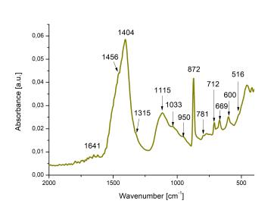
FTIR analysis
1.2,I layer
1 mm
The FT-IR analysis reveals the presence of:
calcium carbonate (712, 872, 1404 cm⁻¹),
iron, potassium, and manganese silicates
and oxides (455, 770, 872, 950, 1011, 1404 cm⁻¹).
Additionally, a substantial quantity of calcium oxalates was identified, indicated by absorbance bands at
516 (sh), 781, 1315 (sh), and 1641 cm⁻¹.

Slide 9
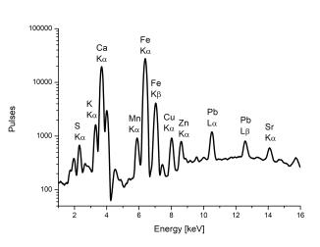
XRF analysis
1.2,II layer
Sample No. | Colour | Elements detected by XRF | Pigments
1.2,II,1 | Brown (dark) | S, K, Ca, Mn, Fe, Cu, Sr, Pb | Iron pigment (umber), gypsum, carbon black (suggested charcoal black)
1.2,II,4 | Blue | Ca, Fe, Cu, As, Sr, Pb | Copper pigment (verditer), lead white (traces), iron pigment (ochre, traces), calcium carbonate
1.2,II,6 | White | S, Ca, Mn, Fe, Sr | Gypsum
1.2,II,8 | Black | S, K, Ca, Mn, Fe, Cu, Zn, Sr, Pb | Carbon black (suggested charred plant black), iron pigment (umber), gypsum
1.2,II,9 | Red | S, Ca, Fe, Cu, Hg | Vermilion, calcium carbonate, gypsum
1.2,II,11 | Green | S, K, Ca, Fe, Cu, Zn, Ba, Pb | Copper pigment (verdigris), iron pigment (ochre, traces), lead white, barium white (traces), calcium carbonate, gypsum
1.2,II,13 | Yellow | S, Ca, Mn, Fe, Cu, Zn, Sr, Ba, Pb | Iron pigment (yellow ochre), calcium carbonate, gypsum
In the painted decoration (1.2,II) located beneath the youngest layer, the following were detected: gypsum, calcium carbonate, yellow ochre, red ochre, vermilion, umber, verditer, verdigris, carbon black. Due to the high potassium (K) content in black areas, charred plant black is suggested.

Slide 10
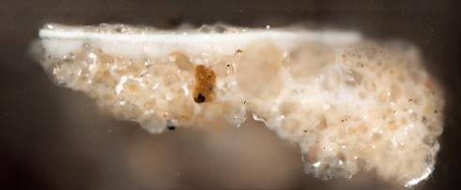
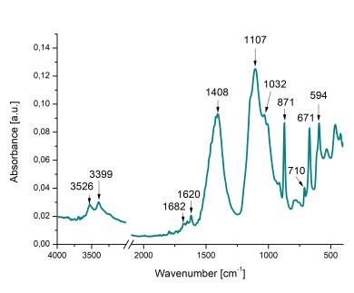
FTIR analysis
1.2,II layer
1 mm
FTIR analysis confirmed the presence of:
gypsum (594, 671, 1107, 1620, 1682,
3399 and 3526 cm⁻¹ ),
calcium carbonate (710, 871,
1408 cm⁻¹ )

Slide 11
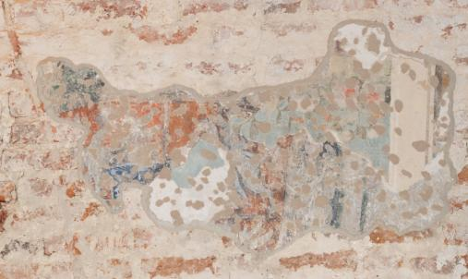
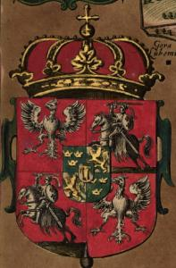
The oldest painted decoration
1.2,III layer
On the southern wall, there is a fragment featuring the coat of arms of the Polish-Lithuanian Commonwealth during the reign of the Vasa dynasty (1587–1668).

Slide 12
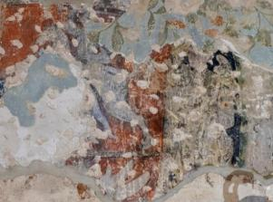
XRF analysis
1.2,III layer
Sample No. | Colour | Elements detected by XRF | Pigments
1.2,III,1 | Red | S, Ca, Fe, Hg, Pb | Lead pigment (minium), vermilion
1.2,III,3 | Blue | Si, K, Ca, Fe, Co, Ni, Cu, As, Hg, Pb, Bi | Cobalt pigment (smalt), copper pigment (azurite)
1.2,III,5 | Green | Ca, Fe, Cu, As, Pb | Copper pigment (malachite), lead white
1.2,III,9 | Yellow | Fe, Cu, Sn, Pb | Tin-lead yellow
In the oldest painted decoration (1.2,III) depicting the coat of arms of the Vasa dynasty and the Polish-Lithuanian Commonwealth, the following pigments were detected: calcium carbonate, tin-lead yellow, vermilion, minium, smalt, azurite, malachite, lead white.

Slide 13
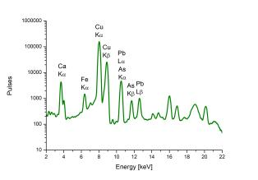
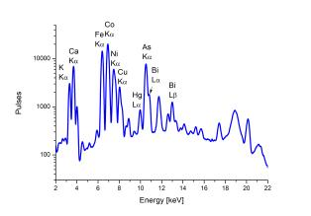
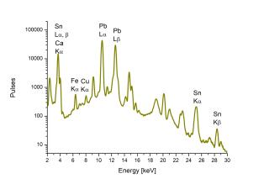
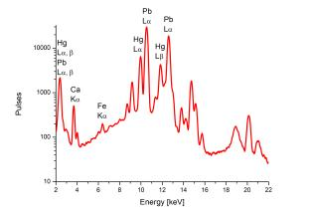

Slide 14
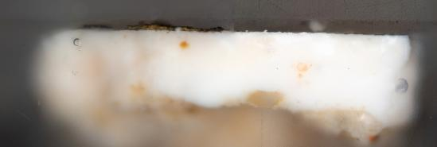
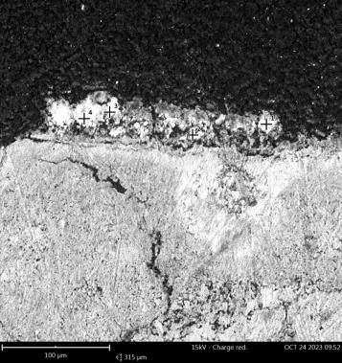
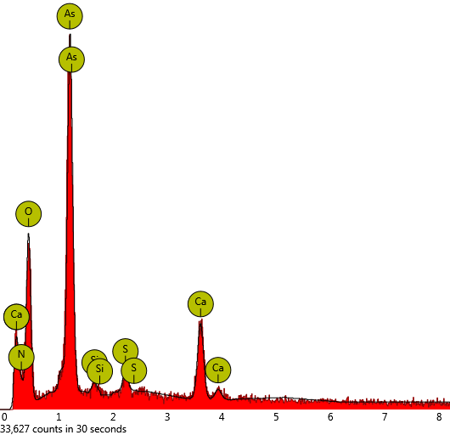
SEM-EDS analysis
1.2,III layer
1 mm
SEM-EDS analysis of a thin, yellow layer of pigment observed in cross-section revealed the presence of arsenic (As) and sulphur (S), indicating the use of orpiment.
The detected pigments are typical for the 17th century and consistent with the dating of the painted coat of arms.

Slide 15
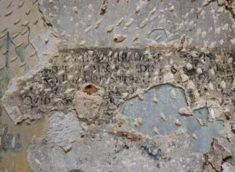
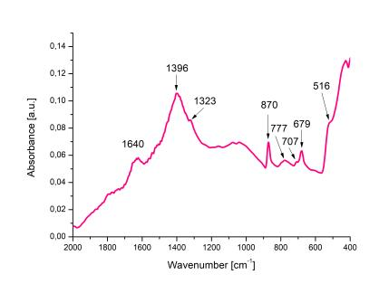
FTIR analysis
1.2,III layer
FTIR analysis of the oldest painted decoration from the coat of arms revealed:
calcium carbonate (707, 870, 1396 cm⁻¹),
calcium oxalates (516, 777, 1323, 1640 cm⁻¹),
indicating the presence of a proteinaceous binder.

Slide 16
Conclusions
In the present investigation, a thorough analysis was conducted on the pigmented plasters discovered at the Saltwork Castle in Wieliczka. The study adopted a comprehensive diagnostic methodology using spectroscopic techniques such as XRF and FTIR, in conjunction with microscopic examinations and chemical stratigraphic characterizations of the pigmented layers. Detailed analyses revealed the presence of pigments typical for the 17th century. Subsequent layers were dated to the 18th century, and the most recent paint layer to the 19th century.

Slide 17
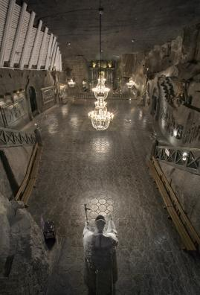
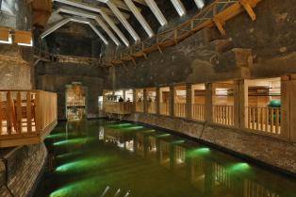
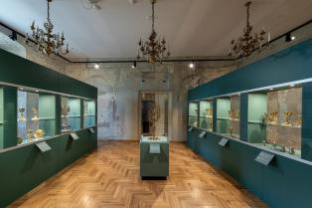
Thank you for your attention!
dr Anna Klisińska-Kopacz aklisinska@mnk.pl
Pamela Grajny-Brzezińska p.brzezinska@muzeum-wieliczka.pl
dr Tomasz Wilkosz twilkosz@mnk.pl
Michał Obarzanowski mobarzanowski@mnk.pl
Klementyna Ochniak-Dudek k.ochniak@muzeum.wieliczka.pl
dr Julio M. del Hoyo Melendez jdelhoyo@mnk.pl

