Slide 1







GC/MS investigations of varnish removal on oil paintings with gelled surfactant-free emulsions made from xanthan gum and benzyl alcohol
Marianna Potenza^{1*}, Silvia Germinario¹, Antonella Casoli¹, Laura Bergamonti¹, Stefano Volpin², Elisa Isella³ and Paolo Cremonesi⁴
¹ Dept. Chemistry, Life Sciences and Environmental Sustainability, University of Parma, Parco Area delle Scienze 17/A, 43124 Parma, Italy
² Gallerie dell’Accademia di Venezia, Scientific Laboratory, Cannaregio 3553, 30131 Venezia, Italy
³ Paintings conservator, Breraut Restauri Srls, Loc. Sossana 12, 22025 Lezzeno, Italy
⁴ Freelance Conservation Chemist, 26900 Lodi, Italy
Dott.ssa Marianna Potenza, Ph.D. Chemical Sciences
marianna.potenza@unipr.it

Slide 2
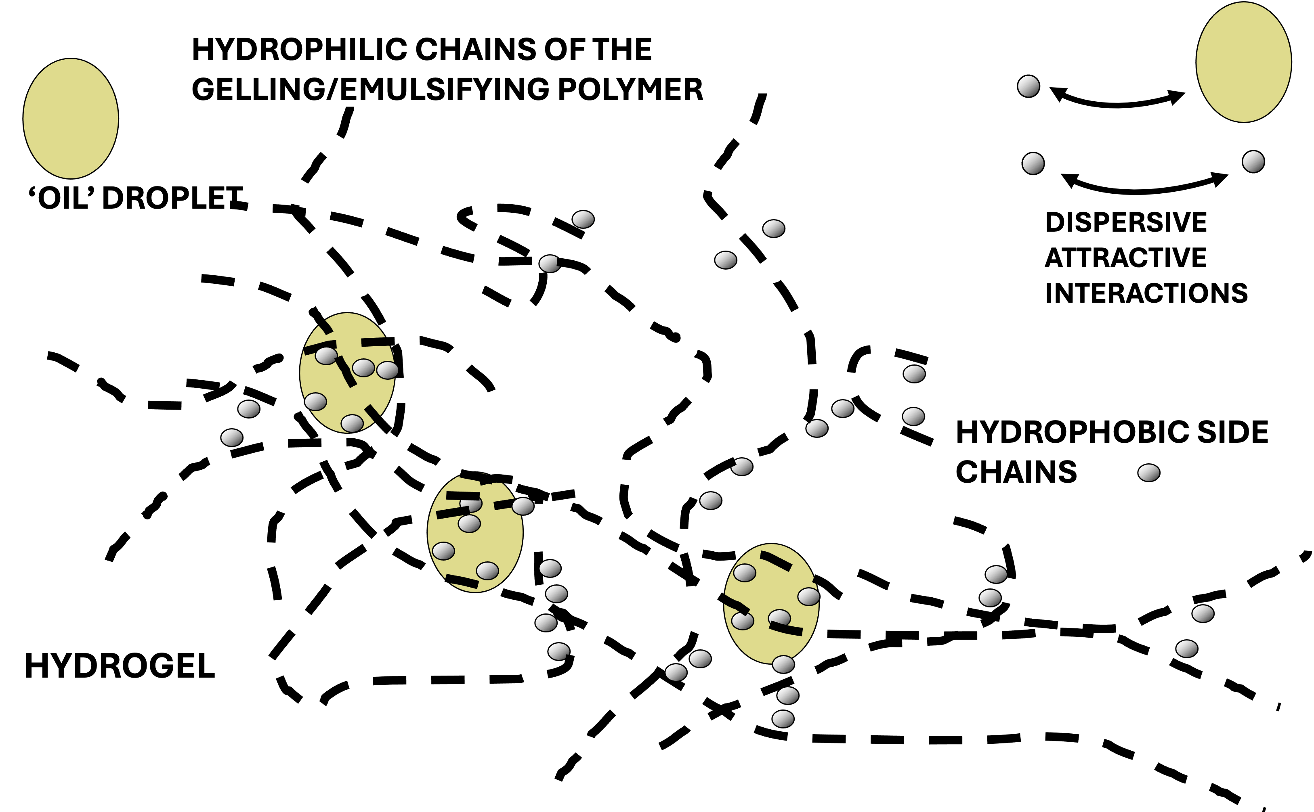
Thickener: hydrophilic molecules
Addition of hydrophobic portions
Polymeric emulsifiers: stabilize colloidal dispersions
of two immiscible liquids
Surfactant-free oil-in-water emulsions
Removal of varnishes and retouches and organic film-forming substances
Benzyl alcohol containing emulsions
Pros:
no surfactant use (liquids diffuse under porous surfaces, non-volatile substances, residues, with potential interactions with paint media)
low-toxicity
Cons:
low volatility and high solvent power
No use in the form of a free solvent but use to create oil-in-water emulsions and in this form its action is believed to be more controllable.
Temporary hydrophobization with D5
Immiscible with water

Slide 3
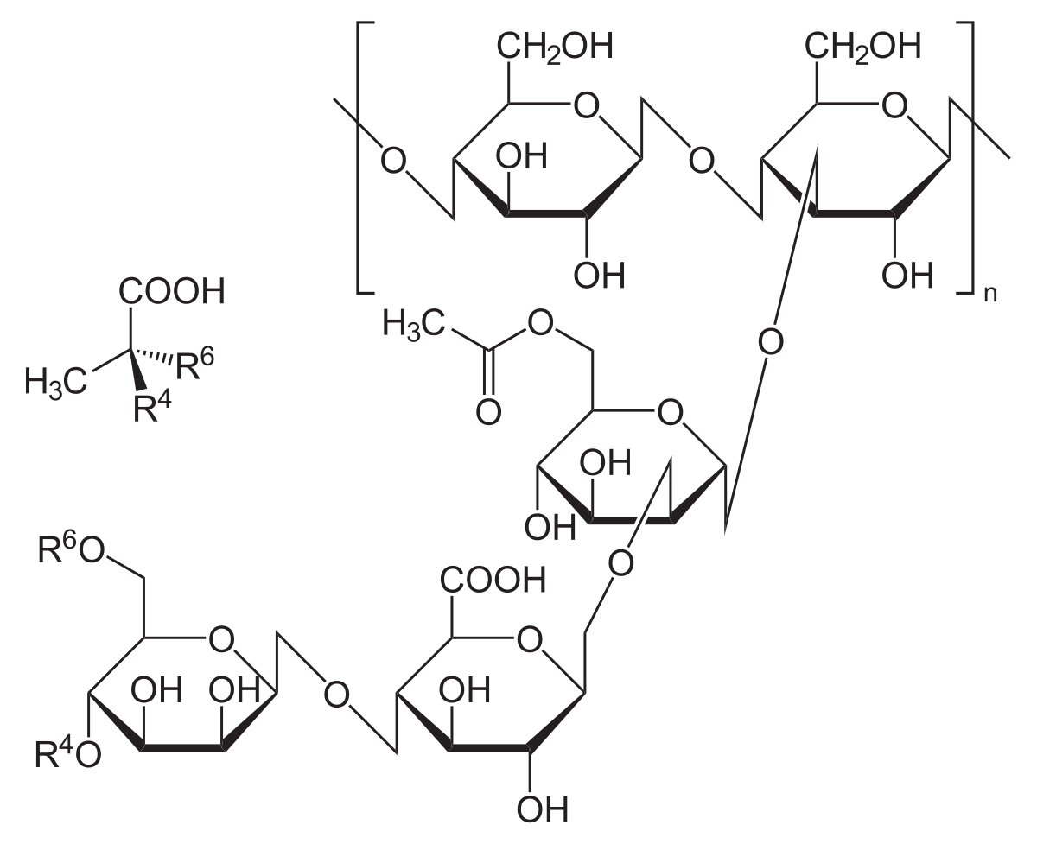
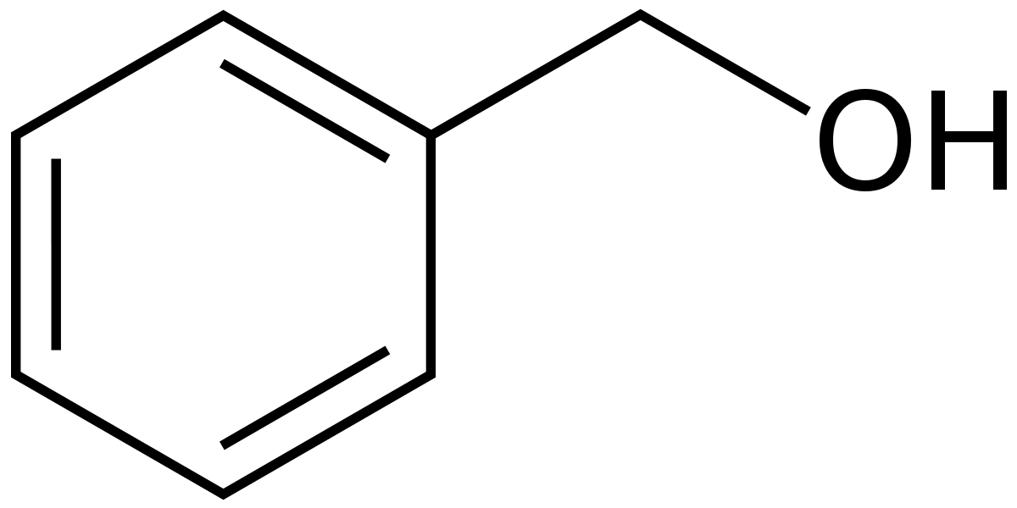
AIMS OF RESEARCH
verify the effectiveness of the temporary hydrophobization technique;
analytically verify the assumption that the action of benzyl alcohol is more controllable in emulsion form
Gelled o/w emulsions with:
3% xanthan gum hydrogels made from pH 7 phosphate and pH 8.5 pyrophosphate buffers.
5% benzyl alcohol.
comparison with and without D5
Surface characterization:
Infrared spectroscopy FT-IR and scanning electron microscopy with Energy Dispersive System (SEM-EDS).
Removal capacity:
Fatty acid content was determined by Gas Chromatography coupled with Mass Spectrometry (GC/MS) measurements.

Slide 4
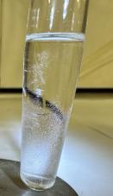
Quantifying the immiscibility of the two organic solvents
Varnish removal tests
Sample | Benzyl Alcohol | D5
0 | Liquid Form | No
0D | Liquid Form | Yes
Abundance
D5 Phase
Time
Abundance
Benzyl Phase
Sample | Gelled Emulsion | pH | D5
1 | Phosphate Buffer | 7 | No
1D | Phosphate Buffer | 7 | Yes
2 | Diphosphate Buffer | 8.5 | No
2D | Diphosphate Buffer | 8.5 | Yes
Time
D5 phase with 234.74 ppm of Benzyl Alcohol
Benzyl phase with 40967.79 ppm of D5

Slide 5
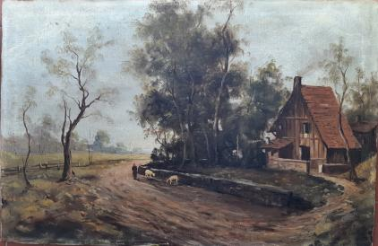
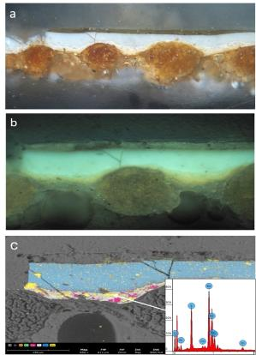
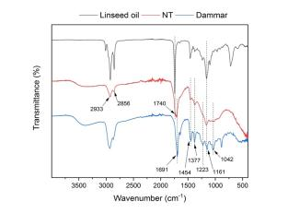
Surface characterization: SEM-EDS and FT-IR
Oil painting on canvas, 50 x 70 cm, by Angelo Pratesi, 20th century
Lipidic fraction
and natural resin

Slide 6
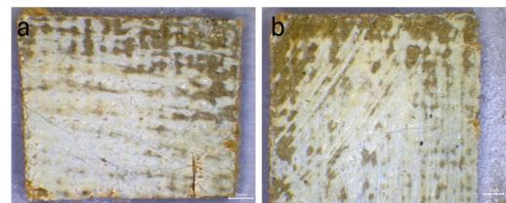
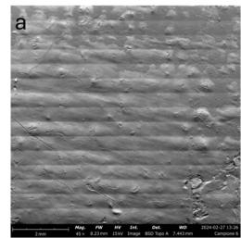
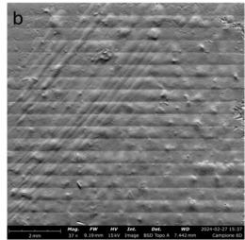
SEM investigations
Visible image of surface of the sample 2 a) and sample 2D b)
c
d
No interactions were highlighted that led to alterations in the topography of the paint layer, regardless of the presence or absence of the silicone solvent barrier.
Topographic SEM images of surface of the samples 2 a) and 2D b).

Slide 7
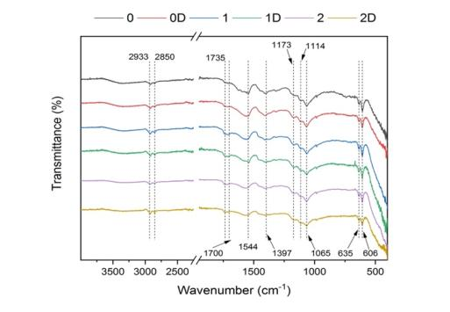
FT-IR Spectroscopy
GC/MS
pH 7
pH 8.5
Barium sulfate: 1173 cm⁻¹, 1114 cm⁻¹, 1065 cm⁻¹ ,
635 and 606 cm⁻¹
Lipidic fraction reduced
Terpene resin in trace
Strong swelling ability of the Benzyl Alcohol towards the oil medium and its strong solvent power.
Pre-saturation of the surface with D5 reduced the leaching.

Slide 8
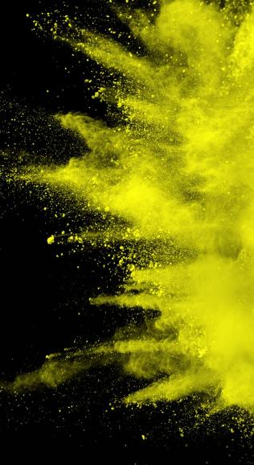
CONCLUSIONS
Moderate quantity of benzyl alcohol, equal to 5% (w/v), emulsified in an aqueous gel maintained adequate solvent power to remove the aged natural resin.
Benzyl alcohol interacts with the oil paint medium, causing leaching of fatty acids. A neutral value, non-ionizing towards the acidic components of the varnish and the paint binder, guarantees less interaction.
Protecting the surface with siloxane has proven to be an only partially effective strategy. Leaching decreases.

Slide 9

Thank you for your attention

