Slide 1
The condition survey of Tavole Palatine and Metaponto Archaeological Site Park
Annamaria Mauro¹, Barbara Brunetti¹, Direzione regionale musei Basilicata Sonia Cattazzo², Francesco Rizzi², Roberta Giorio², CMR Center Material Research Simona Armenise³, Free lance conservator
Vasco Fassina⁴, Free lance conservation scientist
vasco.fassina@gmail.com
Florence Heri-tech 2024
April 29-30, 2024

Slide 2
In the framework of an extensive project finalized to the conservation and valorization of the Tavole Palatine and the Metaponto Archaeological Site Park located in the South of Italy, the museum directorate of Basilicata region decided to carry out a campaign on chemical-physical, mineralogical-petrographic and thermographic investigations during 2023 winter-spring period.
The following archaeological monuments of Greek origin were considered: Tavole Palatine, Ekklesiasterion Theatre and Hera, Ionic, Apollo Temples.
The results of the investigations presented in this paper will be used to design a pilot study to be carried out in the archaeological site in order to identify the most suitable restoration procedures for the conservation of the ancient Greek monuments.
The investigations carried out showed that the deterioration processes are mainly influenced by biodeteriogenic agents associated with natural weathering.

Slide 3
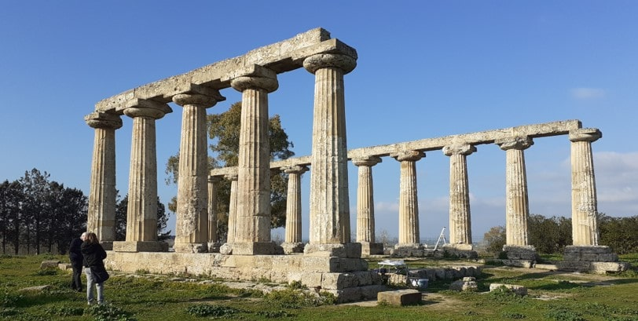
The Tavole Palatine are the most significant remains currently existing and represent a historical and structural relevance,
however its current condition shows some relevant missing of architectural elements due to exposure to natural atmospheric agents.

Slide 4
On the basis of a preliminary diagnostic plan aimed at developing a correct aesthetic and conservative restoration intervention, supported by scientific evidence and characterized by technical-scientific principles of biocompatibility and eco-sustainability, it was possible to identify the most significant conservation issues that require further diagnostic investigations to support and guide both a future restoration intervention and the study of the historical-artistic techniques and materials used.
The preliminary study was carried out in two steps;
the characterization of the constituent materials and of the deterioration products,
based on the results obtained, an on-site pilot survey will be carried out to establish the most suitable methodologies for the removal of biodeteriogenic agents and for the choice of consolidation and protection products.

Slide 5
Investigations carried out
Thermographic survey
Physical behaviour of materials towards liquid and water vapour
Characterization of stone materials
Characterization of grouting mortars and plasters
Tavole Palatine
Ionic Temple
Hera Temple
Apollo Temple
Ekklesiasterion Theater
Characterization of
surface finishes,
salt efflorescences
biodeteriogens

Slide 6
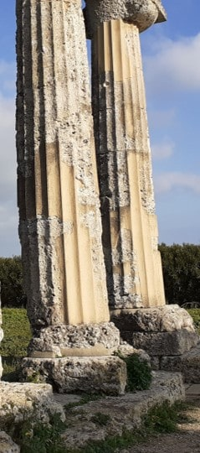
water exchange characteristics of the original stone and the restoration plaster applied on missing areas. WA values measured (12%) are similar to porous stone such as Lecce Calcarenite Stone or Vicenza Stone

Slide 7
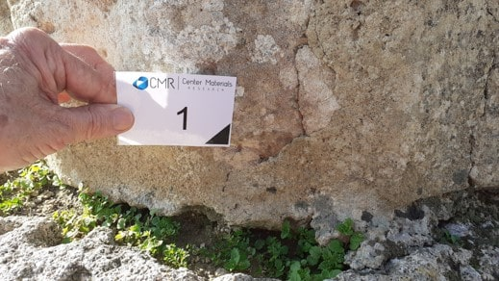
First type of grouting mortars and plasters yellowish-grey coloured are: cement and lime as binders + fine aggregate which have a similar composition of Tavole Palatine stones
Characterization of grounting mortars and plasters
Tavole Palatine two typology of grounting mortars were found
MO cross section (40x), from down to up:
a) yellow substrate, b) green biofilm;
c) white patina

Slide 8
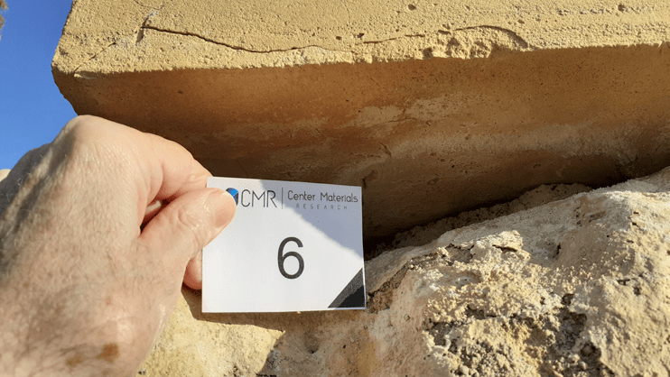
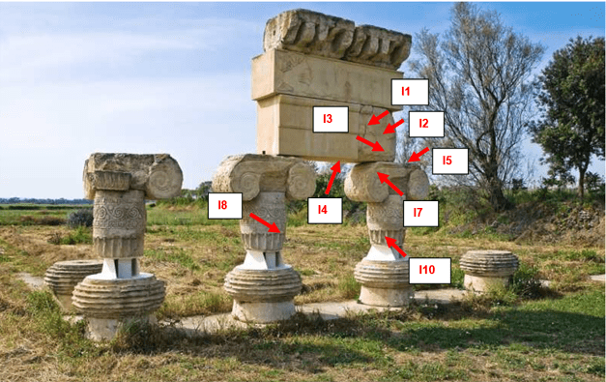
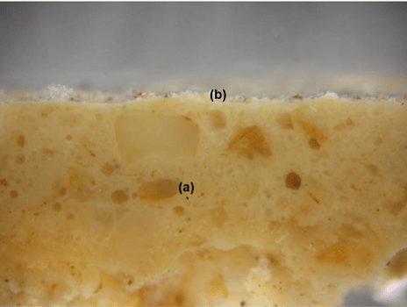
Ionic Temple
Grounting mortars have a similar composition of Tavole Palatine
The difference is the presence of white Portland cement.
MO Cross section:
a) yellow intonachino containing cyanobacteria and fungi,
b) white layer of gypsum and oxalate

Slide 9
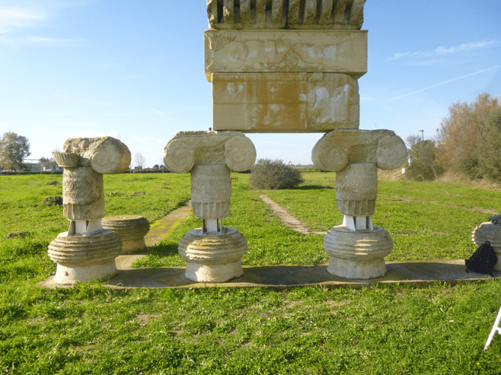
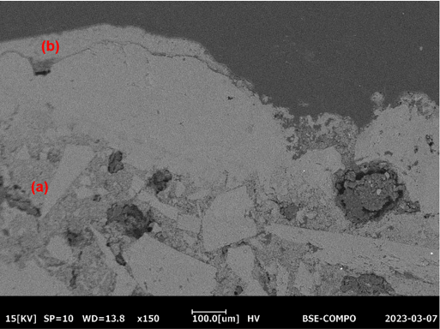
Ionic Temple-reconstructed lintel
salt efflorescences -sodium sulphate from cement mortar used in the reconstruction
SEM cross section: a) mortar layer (3-6 mm)
b) Gypsum sulphation layer (100 µm)

Slide 10
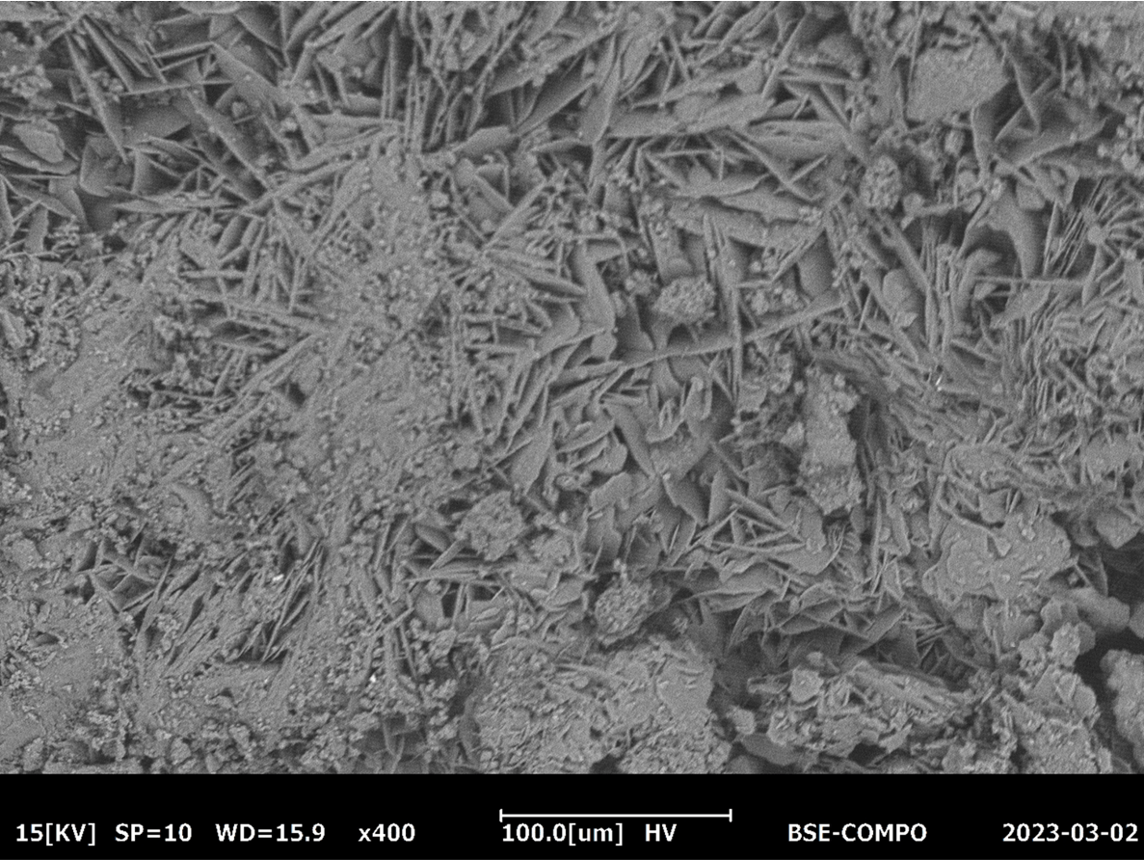

Slide 11
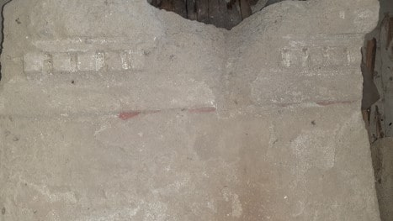
Surface finishes
Red colour trace remains on the original stone
surface actually recovered in the lapidarium
MO cross section
c) surface finish red ochre-based,
b) red plaster layer (putty-lime+marble fragments
fine red ochre pigment
a) ground white plaster layer

Slide 12
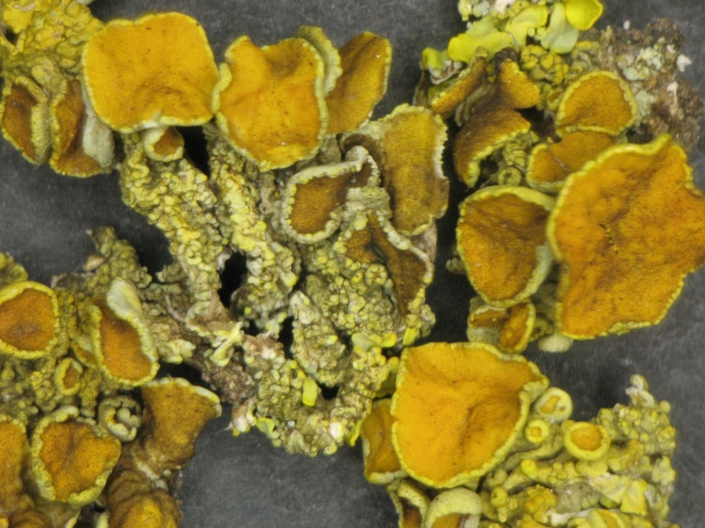
MO cross section a) : brown fungal iphae up to 2.5 mm depth + melanin black colour b): Biological patina few green algae + brown lichen Verrucaria nigrescens + many fungal iphae
Biodeteriogens
extensive presence of biodeteriogens: the prevailing species were lichens communities sometimes in association with algal biofilms and bryophytes
Lichen: Xanthoria parietina

Slide 13
Conclusions
Main issues to be underlined are the presence of restoration plaster and grouting mortar containing cement and synthetic resins which are not compatible with the original stone materials.
In some cases, they are responsible of the formation of salt efflorescences and in other cases they tend to prevent moisture exchange from the underling stone substrate and the atmosphere.
The presence of biodeteriogenic organisms, typical of a rural environment can represent a potential cause of damage to the archaeological remains, especially over long periods of time.
After the restoration intervention in order to prevent the biological action a maintenance conservation plan should be advised approximately every 5 years

Slide 14
Thank you for your attention
vasco fassina@gmail.com
Florence Heri-tech 2024
April 29-30, 2024

